Slide 1
ARP and RARP

Slide 2
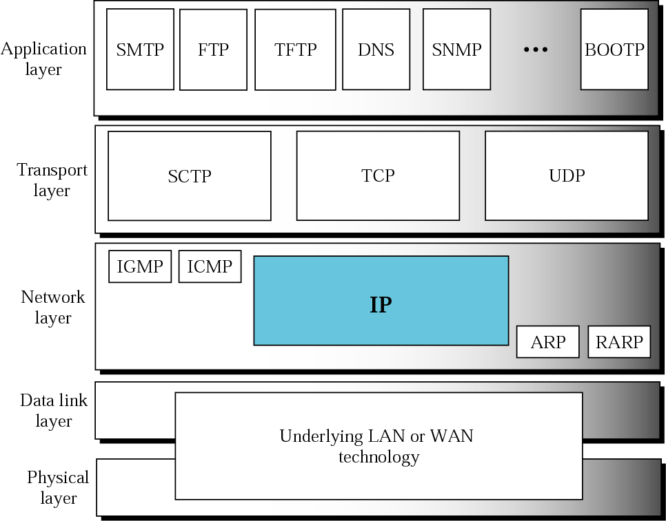

Slide 3
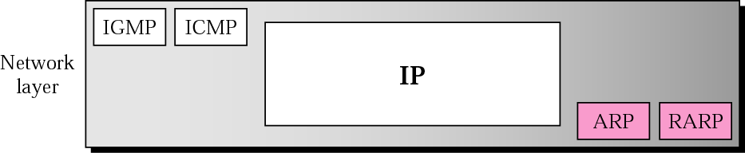

Slide 4
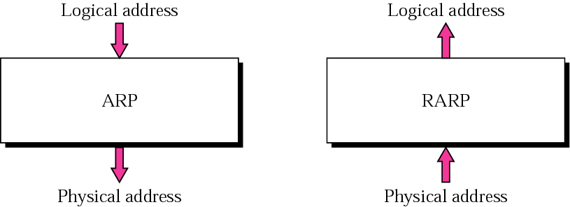

Slide 5
ARP
ARP associates an IP address with its physical address. On a typical physical network, such as a LAN, each device on a link is identified by a physical or station address that is usually imprinted on the NIC.

Slide 6
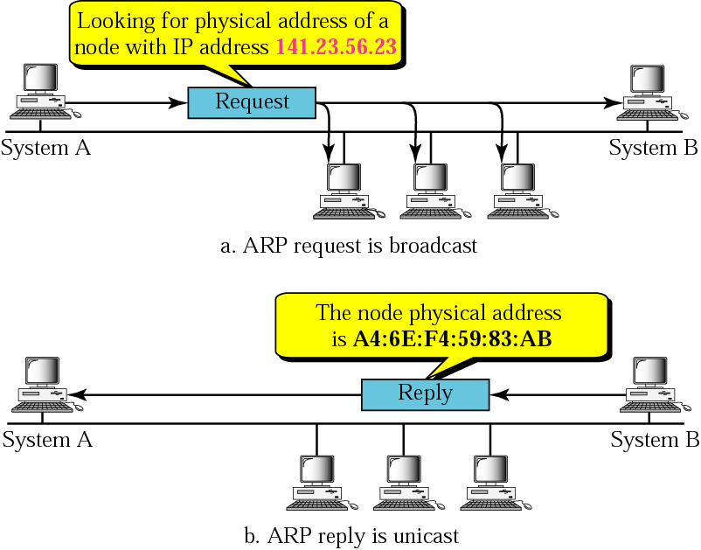
ARP operation

Slide 7
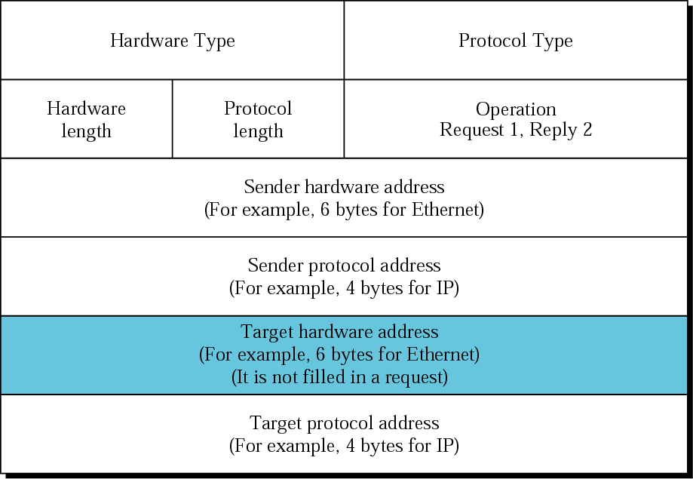
ARP packet

Slide 8
Hardware Type
16-bits, defines type of physical n/w
Ex. Ethernet is given type 1
Protocol Type
16-bits, defines higher-level protocol
Ex. IPv4 is 0x0800
Hardware length
8-bis, defines length of physical address in bytes
Ex. For Ethernet - 6
Protocol length
8-bis, defines length of logical address in bytes
Ex. For IPv4 - 4
Operation
16 bits, defines type of packet
ARP Request(1), ARP Reply(2)
Sender hardware address
Sender Protocol address
Target hardware address
Target Protocol address
Variable Length

Slide 9
Q : What will be the Target h/w address in case of ARP request ?

Slide 10
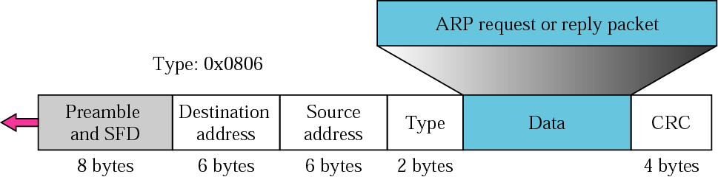
Encapsulation of ARP packet
Q: What will be Destination address here incase of ARP request and ARP reply ?
Preamble – 56 bits – fixed pattern – alternate 1 and 0
SFD – Start Frame Delimiter – 8 bits – fixed value - 10101011

Slide 11
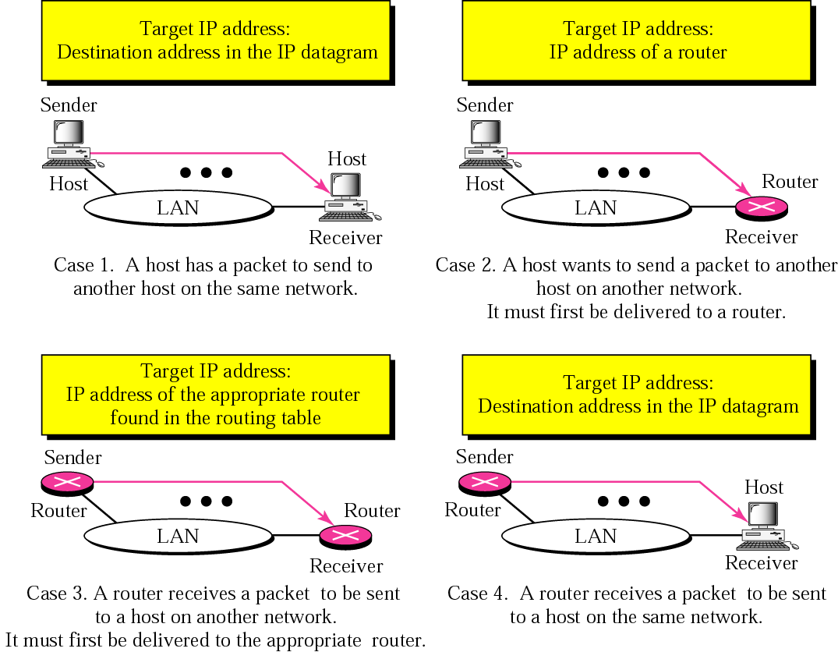
Four cases using ARP

Slide 12
Example
A host with IP address 130.23.43.20 and physical address B2:34:55:10:22:10 has a packet to send to another host with IP address 130.23.43.25 and physical address A4:6E:F4:59:83:AB (which is unknown to the first host). The two hosts are on the same Ethernet network. Show the ARP request and reply packets encapsulated in Ethernet frames.

Slide 13
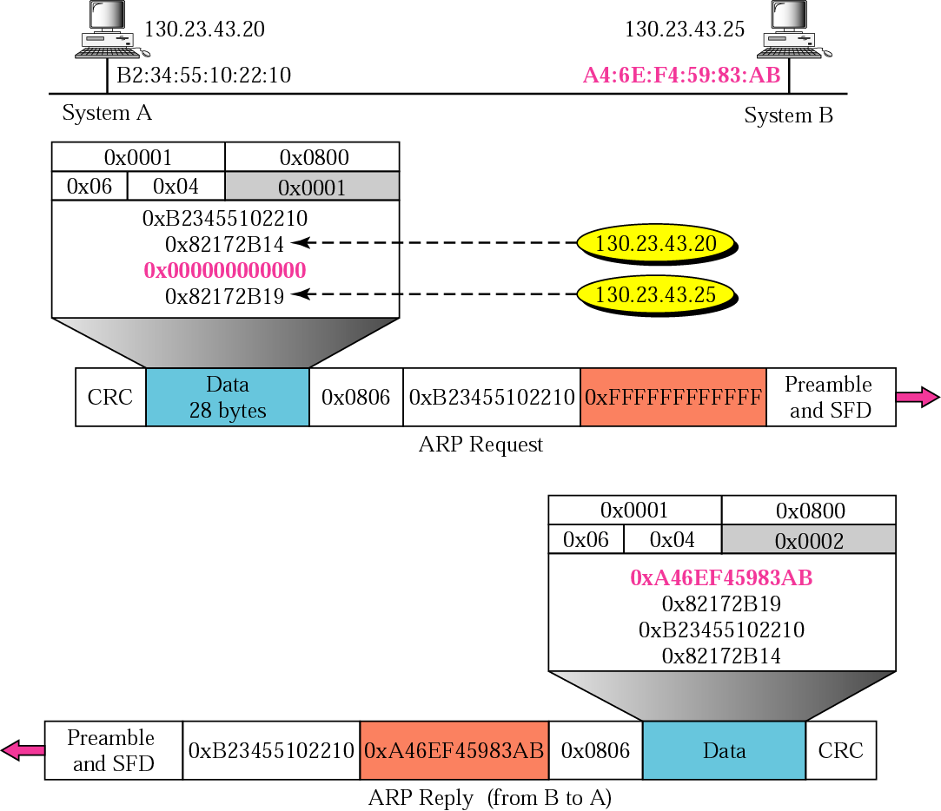

Slide 14
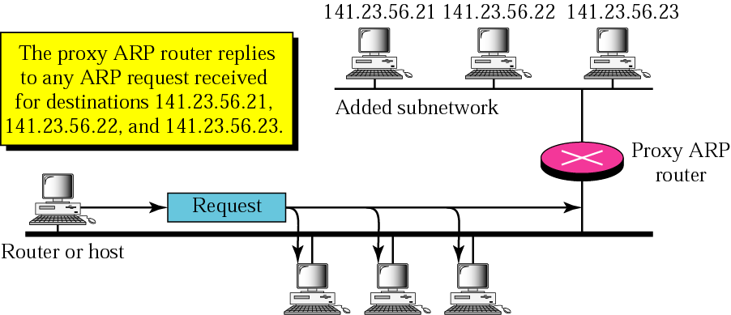
Proxy ARP

Slide 15
RARP
RARP finds the logical address for a machine that only knows its physical address.

Slide 16
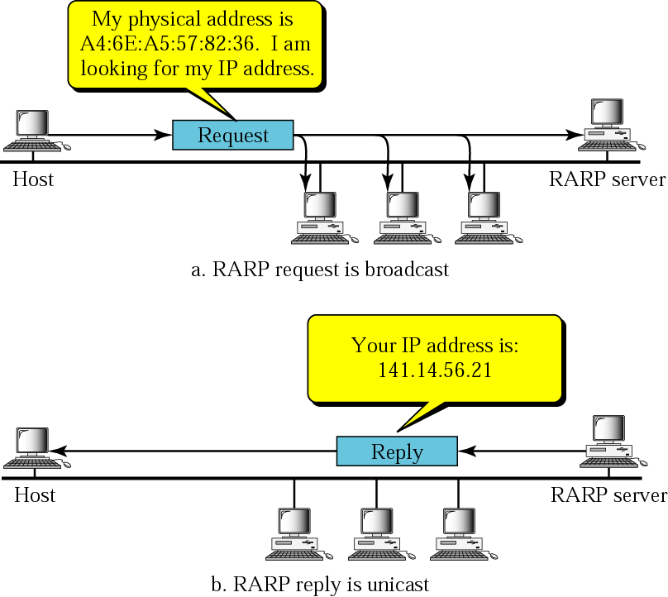
RARP operation

Slide 17
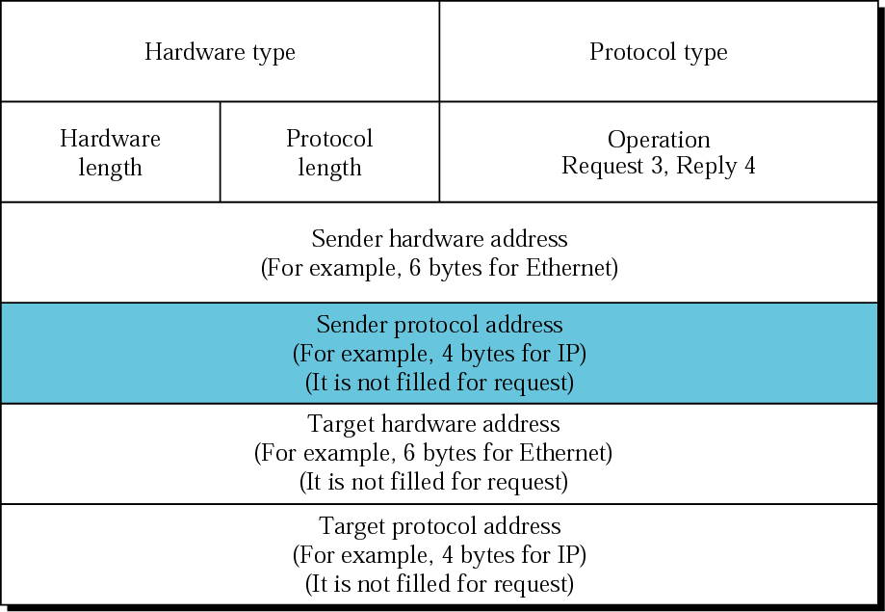
RARP packet

Slide 18
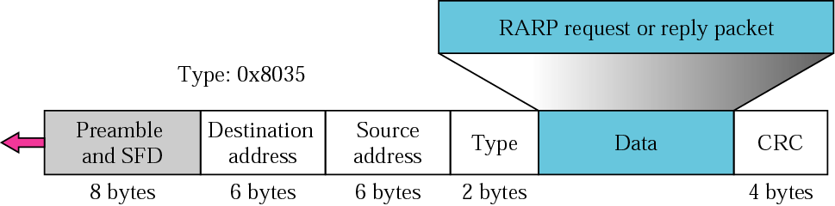
Encapsulation of RARP packet

Slide 19
Host Configuration:
BOOTP and DHCP

Slide 20
BOOTP
The Bootstrap Protocol (BOOTP) is a client/server protocol that configures a diskless computer or a computer that is booted for the first time. BOOTP provides the IP address, net mask, the address of a default router, and the address of a name server.

Slide 21
RARP Vs BOOTP
RARP | BOOTP
Gives only IP address | Gives IP address, net mask, the address of a default router, and the address of a name server
Works at DDL i.e. RARP Client and Server both needs to be in the same network | Works at Application layer i.e. BOOTP Client and Server can be in different network

Slide 22
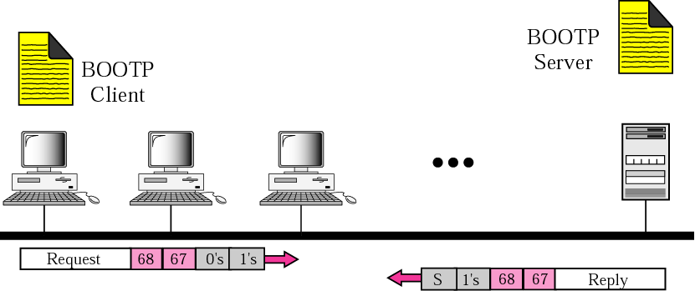
Client and server on the same network

Slide 23
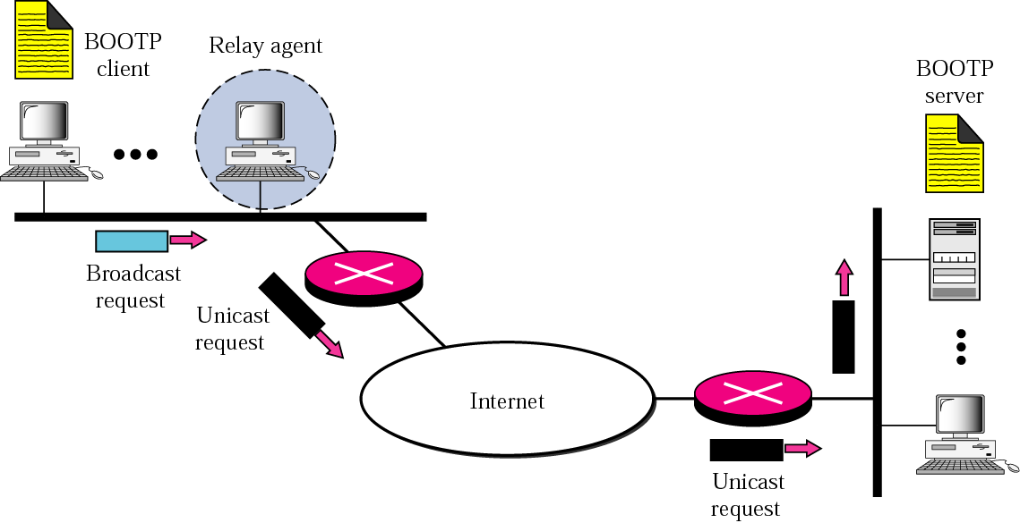
Client and server on two different networks

Slide 24
Note:
The BOOTP server doesn’t send all of the information that a client may need for booting. In reply message, server defines pathname of a file in which the client can find complete booting information. The client can then use TFTP (Trivial File Transfer Protocol)

Slide 25
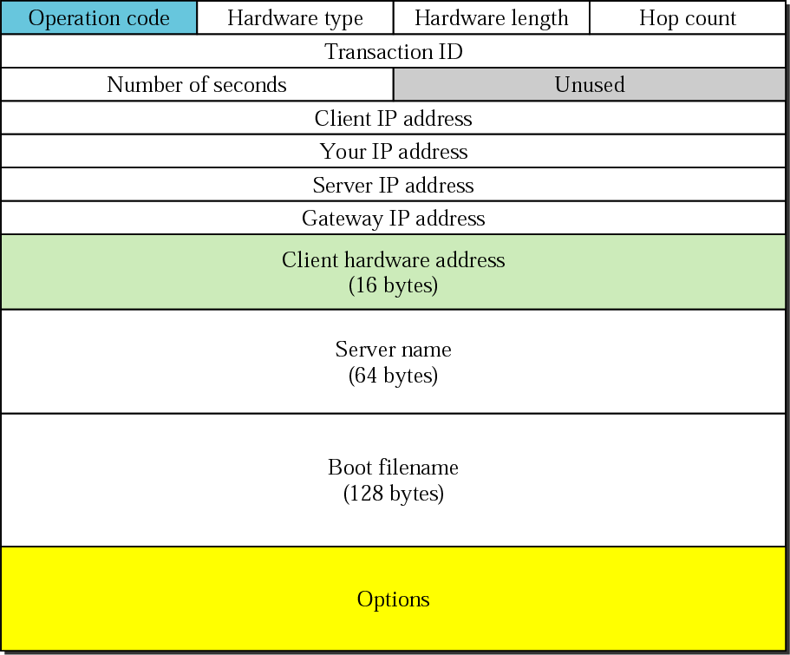
BOOTP packet format

Slide 26
Operation Code
8-bits, defines type of BOOTP packet
request(1) or reply(2)
Hardware Type
8-bits, defines type of physical network
Hardware length
8-bits, defines length of physical address in bytes
Hop Count
8-bits, defines max hops packet can travel
Transaction ID
4-bits, set by client to match reply with request
Server returns same value in reply
Number of seconds
16-bits, indicates no of seconds elapsed since the time client started to boot

Slide 27
Client IP address
4-bytes, contains client IP address
Your IP address
4-bytes, contains client IP address
Filled by server
Server IP address
4-bytes, contains server IP address
Filled by server
Gateway IP address
4-bytes, contains router IP address
Filled by server
Client hardware address
16-bytes, contains client physical address
Server name
Optional 64-bytes, contains null terminated string which specifies domain name of the server
Filled by server

Slide 28
Boot filename
128 bytes, contains null terminated string consisting of full pathname of the boot file
Filled by server
Options
64-bytes
Can carry additional info or some specific vendor info
Filled by server in reply message
Server uses magic cookie 99.130.83.99
When client read this magic cookie, it will look for options in next 60 bytes
Option is composed of : 1-byte tag field, 1-byte length field, and a variable –length value field

Slide 29
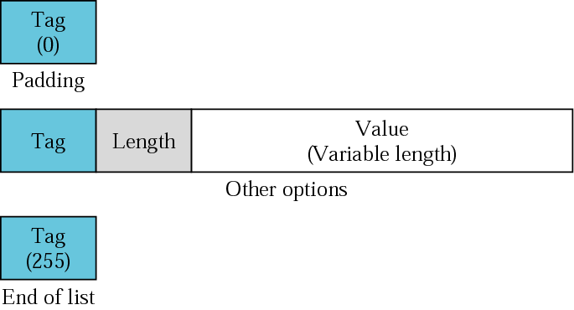
Option format

Slide 30
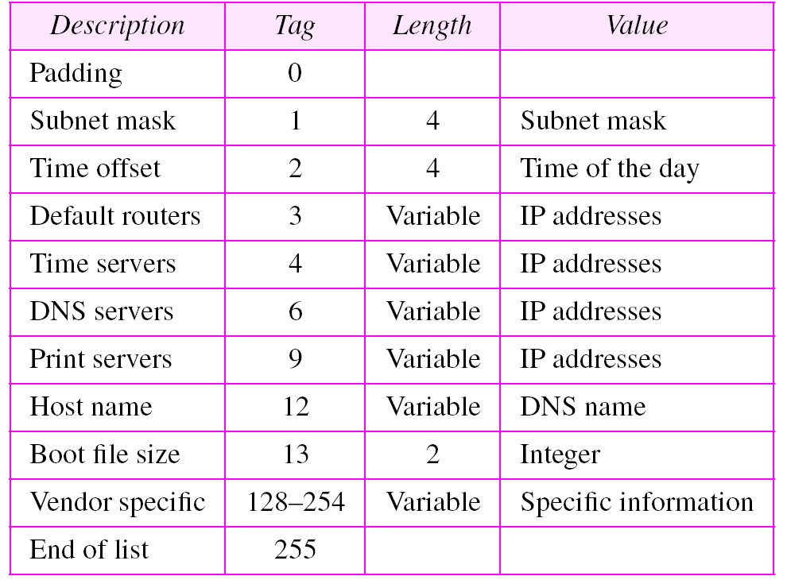
Options for BOOTP

Slide 31
What if host moves from one physical network to another?
What if host wants a temporary IP address?

Slide 32
DHCP
The Dynamic Host Configuration Protocol (DHCP) provides static (like BOOTP) and dynamic address allocation.

Slide 33
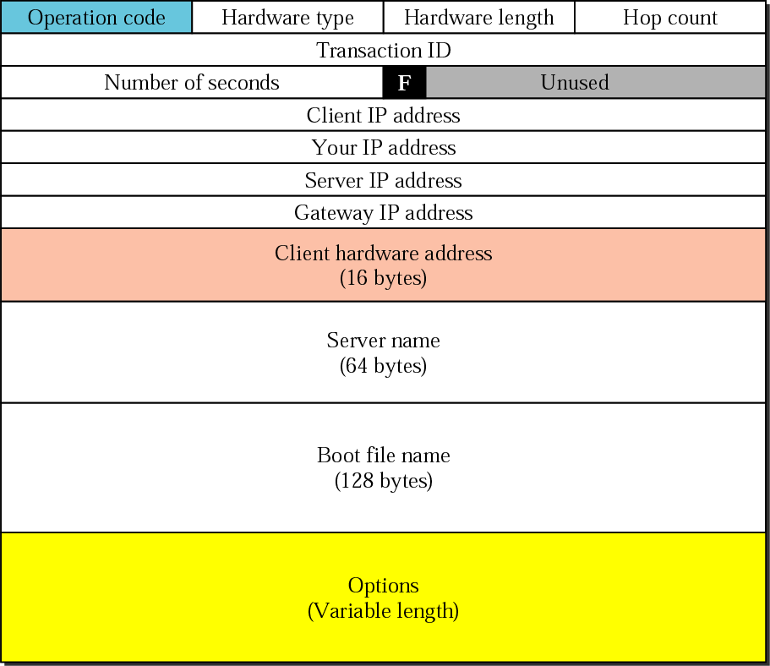
DHCP packet

Slide 34
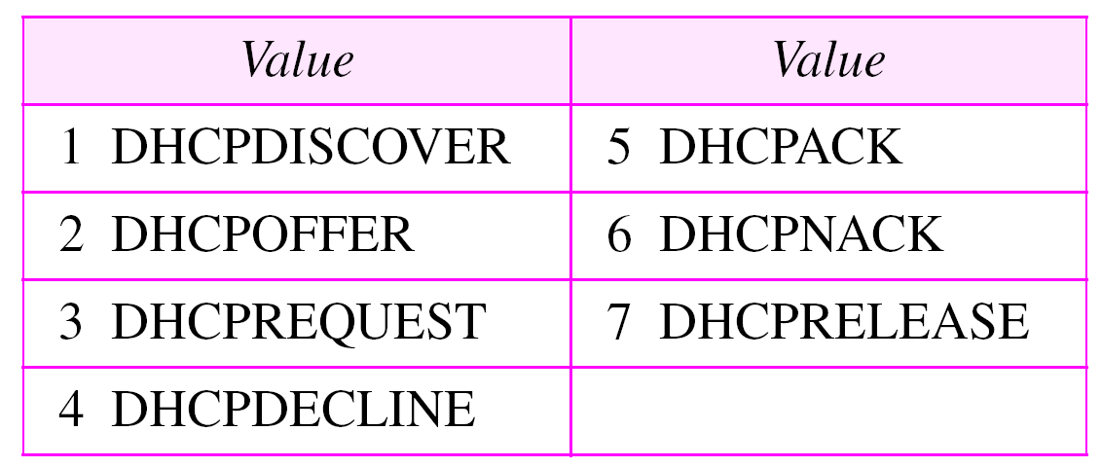
Additional fields
Flag
1-bit, specifies forced broadcast reply from server
Options
Can be up to 312 bytes
Defines parameters such as lease time
Options for DHCP

Slide 35
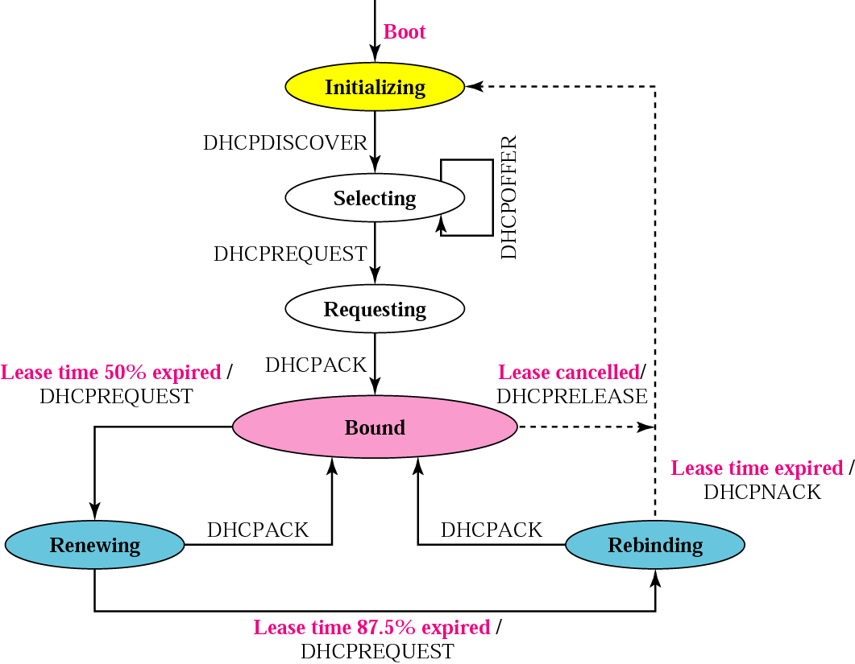
DHCP transition diagram

